Slide 1

Summer Internship Program 2021 (Week 3)
Presented BY : SHUBHAM KUMAR VISHNOI
MCA 4 SEM

Slide 2
What will be talk about :
Comparison between front end vs back end
Defining HTML ,CSS , JAVA-SCRIPT

Slide 3
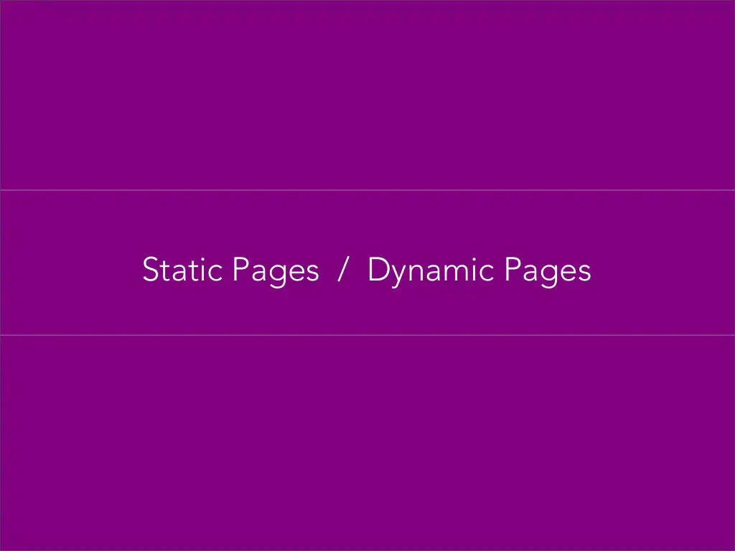

Slide 4

SERVER
pag e.html
pa ge.htm l
pa ge.htm l
A static website is a group of self-conta ined,
individual pages (or pa ge), sent to the browser from
the server one-pa ge-at-a -tim e.

Slide 5
SERV ER
page.ht ml

Slide 6

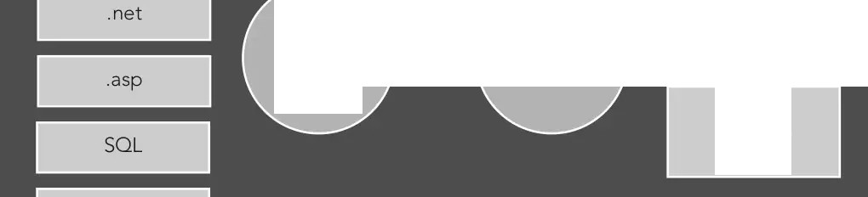
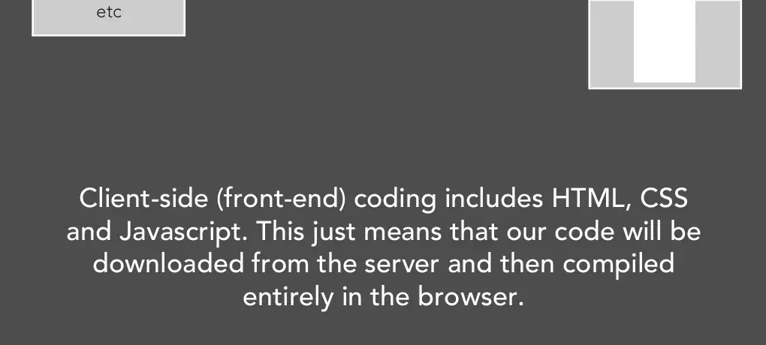
SERVER
pa ge.htm l
style.css
script.js

Slide 7
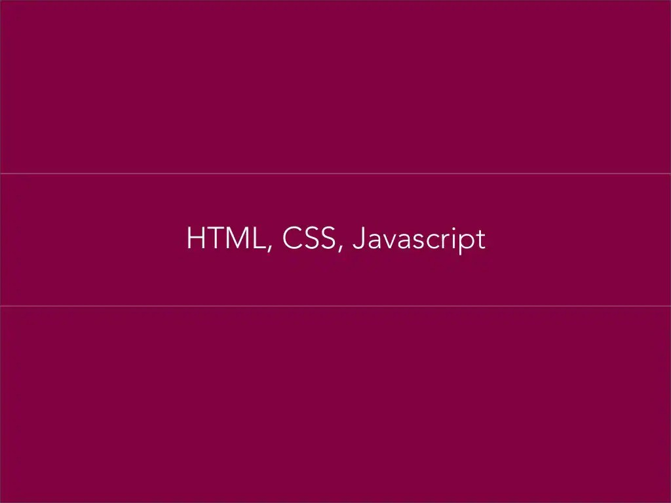

Slide 8
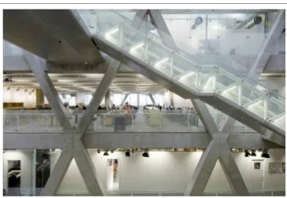
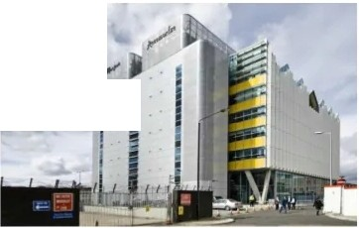
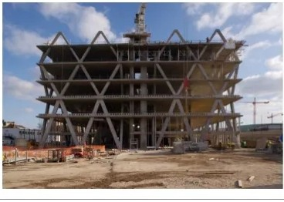
BEHAVIOR
Javascript
PRESENTATION
css
Imagery
I
I
STRUCTURE
HTML markup Site planning

Slide 9


Slide 10


Slide 11
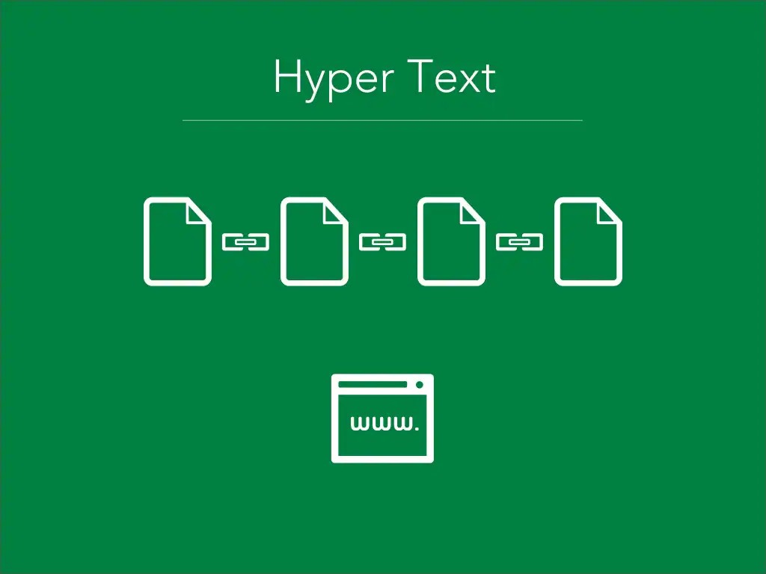

Slide 12
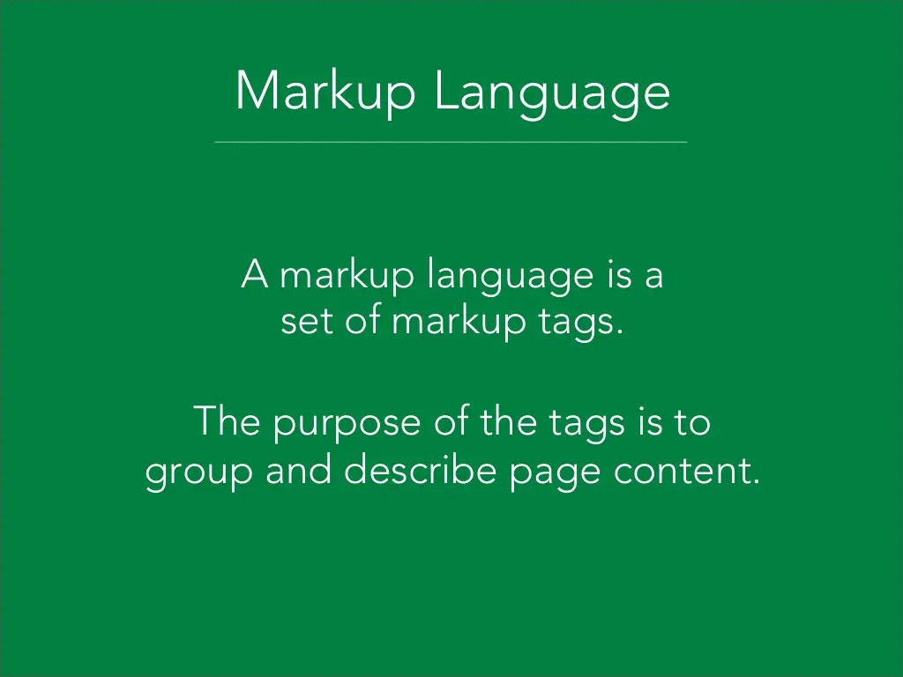

Slide 13

Document Hierarchy: Parents, children and siblings
Just as in a genealogy tree, the family hierarchy is describe d in terms of relationships. All elements in the document have a parent (up to 'document', which is at the top), and may have children (nested inside) or siblings (placed alongside).
<parent x>
<child and sibling y> </child and sibling y>
I I I
<child and sibling z> </child and sibling z>
CJ CJ CJ
</parent x>

Slide 14
The essent ia l element tags
0
Primary Structure
html head
body
Structural Elements (block)
p br
h1 - h6 ul
ol
a
1 mg
(div)
Formatting Elements (inline)
em
strong b
q blockquote (span)
Head Elements
title meta
link
.

Slide 15
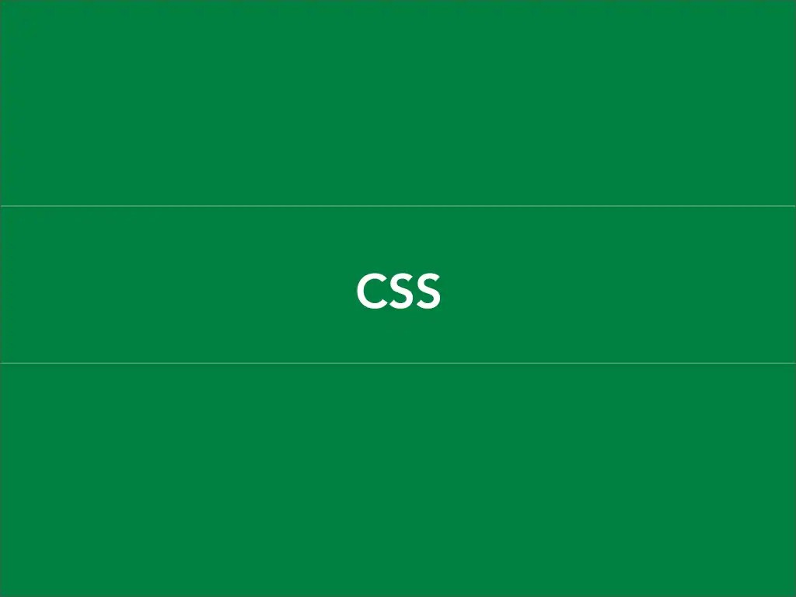

Slide 16
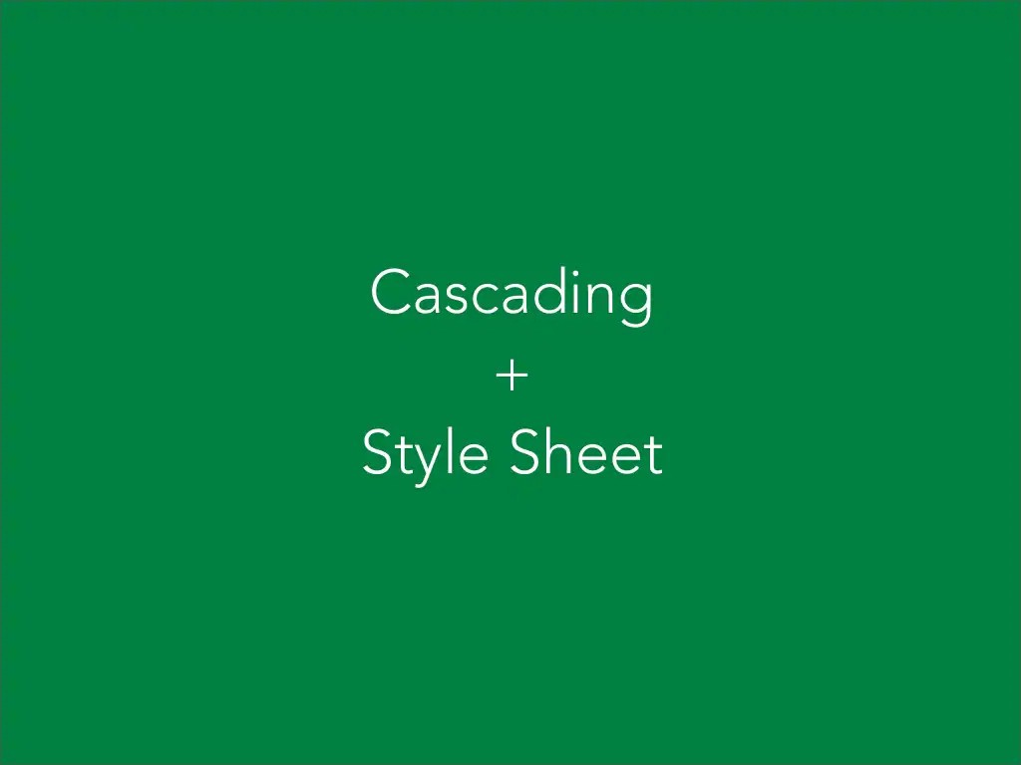

Slide 17
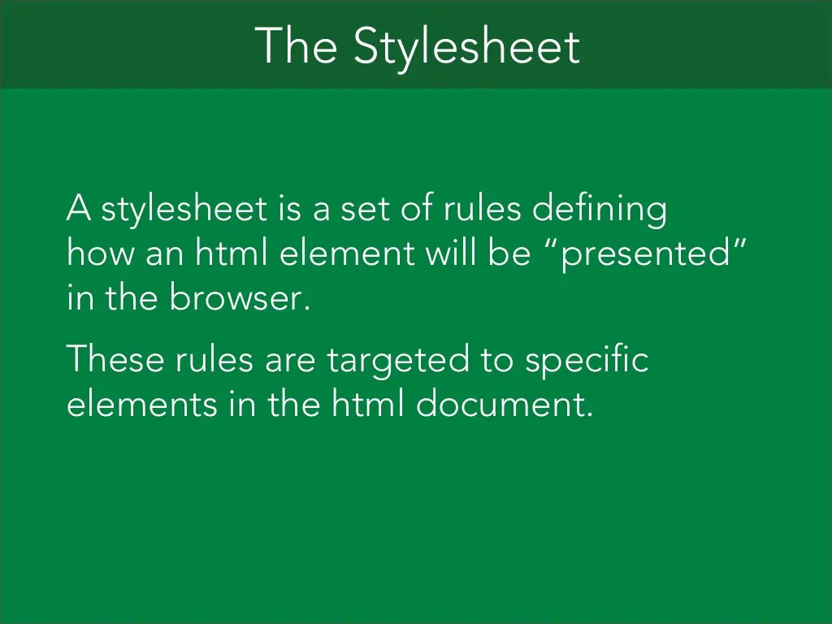

Slide 18
The Cascade
The "cascade" part of CSS is a set of rules for resolving conflicts with multiple CSS rules applied to the same elements.
For example, if there a re two rules defining the color or you r h1 elements, the rule that comes last in the cascade order will
"trump" the other.

Slide 19


Slide 20


